Slide 1
TCP and OSI Communication Model

Slide 2
Session Objectives
After completion of the session you will be able to understand
Layered model of communication
OSI model of communication
Working of each layer in OSI
TCP/IP model of communication
Comparison of OSI and TCP/IP model

Slide 3

Introduction
The Layering Principle of Communication (illustrated in adjacent figure).
The three entities are involved Sender, Carrier, Receiver.
Carrier: Ethernet Cables, Wireless, Optical Fiber, Satellite.
Protocol: A set of rules for communication.
Hardware infrastructure for interconnection.
User Interface for communication.

Slide 4
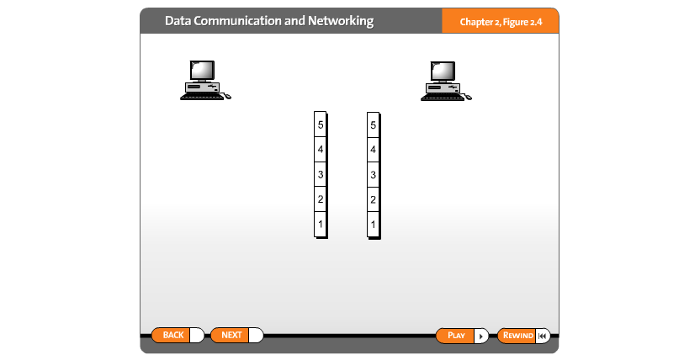
Layered Communication
.

Slide 5

OSI Layered Model
Introduced in 1970.
OSI Stands for Open Systems Interconnection.
An ISO standard that covers all aspects of network communications.
Its goal is the interoperability of diverse communication systems with standard communication protocols.
Here, a layer serves the layer above it and is served by the layer below it.
OSI had two major components,
  Basic Reference Model or Seven Layer model,
  A set of specific protocols.

Slide 6

Layers Interconnection in OSI Model

Slide 7

Data Exchange in OSI Model
Each Layer Description is shown in subsequent slides

Slide 8

Physical Layer
The physical layer is responsible for movements of individual bits from one hop (node) to the next.

Slide 9
The functions of the physical layer are as follows:
Bit synchronization: The physical layer provides the synchronization of the bits by providing a clock. This clock controls both sender and receiver thus providing synchronization at bit level.
Bit rate control: The Physical layer also defines the transmission rate i.e. the number of bits sent per second.
Physical topologies: Physical layer specifies the way in which the different, devices/nodes are arranged in a network i.e. bus, star, or mesh topology.
Transmission mode: Physical layer also defines the way in which the data flows between the two connected devices. The various transmission modes possible are Simplex, half-duplex and full-duplex.

Slide 10

Data Link Layer
The data link layer is responsible for moving frames from one hop (node) to the next.

Slide 11
The functions of the Data Link layer are :
Framing: Framing is a function of the data link layer. It provides a way for a sender to transmit a set of bits that are meaningful to the receiver. This can be accomplished by attaching special bit patterns to the beginning and end of the frame.
Physical addressing: After creating frames, the Data link layer adds physical addresses (MAC address) of the sender and/or receiver in the header of each frame.
Error control: Data link layer provides the mechanism of error control in which it detects and retransmits damaged or lost frames.
Flow Control: The data rate must be constant on both sides else the data may get corrupted thus, flow control coordinates the amount of data that can be sent before receiving acknowledgement.
Access control: When a single communication channel is shared by multiple devices, the MAC sub-layer of the data link layer helps to determine which device has control over the channel at a given time.

Slide 12

Data Link Layer Hop-to-Hop Delivery

Slide 13

Network Layer
The network layer is responsible for the delivery of individual packets from the source host to the destination host.

Slide 14
The functions of the Network layer are :
Routing: The network layer protocols determine which route is suitable from source to destination. This function of the network layer is known as routing.
Logical Addressing: In order to identify each device on internetwork uniquely, the network layer defines an addressing scheme. The sender & receiver’s IP addresses are placed in the header by the network layer. Such an address distinguishes each device uniquely and universally.

Slide 15

Packet Delivery at Network Layer

Slide 16

Transport Layer
The transport layer is responsible for the delivery of a message from one process to another.

Slide 17
The functions of the transport layer are as follows:
Segmentation and Reassembly: This layer accepts the message from the (session) layer, and breaks the message into smaller units. Each of the segments produced has a header associated with it. The transport layer at the destination station reassembles the message.
Service Point Addressing: In order to deliver the message to the correct process, the transport layer header includes a type of address called service point address or port address. Thus by specifying this address, the transport layer makes sure that the message is delivered to the correct process.
The services provided by the transport layer :
A. Connection-Oriented Service: It is a three-phase process that includes
– Connection Establishment
– Data Transfer
– Termination / disconnection

Slide 18
In this type of transmission, the receiving device sends an acknowledgement, back to the source after a packet or group of packets is received. This type of transmission is reliable and secure.
B. Connectionless service: It is a one-phase process and includes Data Transfer. In this type of transmission, the receiver does not acknowledge receipt of a packet. This approach allows for much faster communication between devices. Connection-oriented service is more reliable than connectionless Service.
* Data in the Transport Layer is called as Segments.
** Transport layer is operated by the Operating System. It is a part of the OS and communicates with the Application Layer by making system calls.
Transport Layer is called as Heart of OSI model.

Slide 19

Process to Process Delivery at Transport Layer

Slide 20

Session Layer
The session layer is responsible for dialog control and synchronization.

Slide 21
The functions of the session layer are :
Session establishment, maintenance, and termination: The layer allows the two processes to establish, use and terminate a connection.
Synchronization: This layer allows a process to add checkpoints which are considered synchronization points into the data. These synchronization points help to identify the error so that the data is re-synchronized properly, and ends of the messages are not cut prematurely and data loss is avoided.
Dialog Controller: The session layer allows two systems to start communication with each other in half-duplex or full-duplex.

Slide 22

Presentation Layer
The presentation layer is responsible for translation, compression, and encryption.

Slide 23
The functions of the presentation layer are :
Translation: For example, ASCII to EBCDIC.
Encryption/ Decryption: Data encryption translates the data into another form or code. The encrypted data is known as the ciphertext and the decrypted data is known as plain text. A key value is used for encrypting as well as decrypting data.
Compression: Reduces the number of bits that need to be transmitted on the network.

Slide 24

Application Layer
The application layer is responsible for providing services to the user.

Slide 25
The functions of the Application layer are :
Network Virtual Terminal
FTAM-File transfer access and management
Mail Services
Directory Services

Slide 26
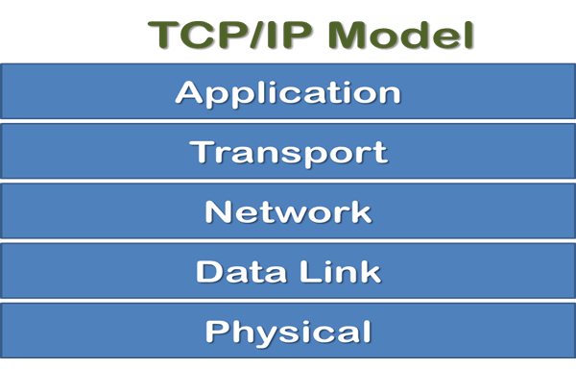
TCP/IP Communication Model
TCP/IP means Transmission Control Protocol and Internet Protocol.
It is the network model used in the current Internet architecture as well.
Developed by Department of Defence's Project Research Agency (ARPA, later DARPA) as a part of a research project of network interconnection to connect remote machines.
Protocols are set of rules which govern every possible communication over a network.

Slide 27
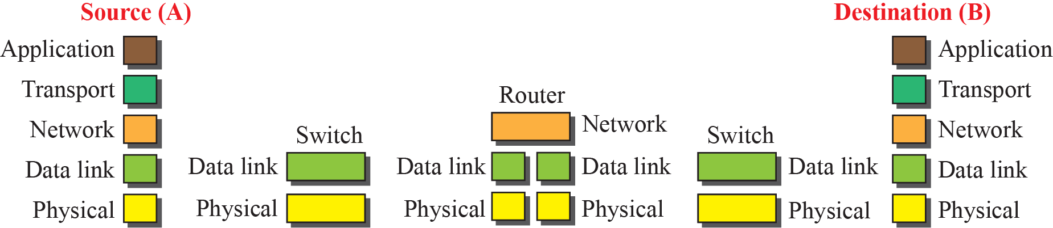
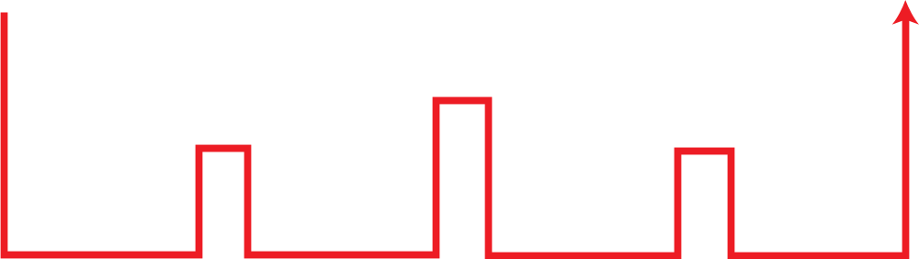
TCP/IP Communication at Data Link Layer

Slide 28
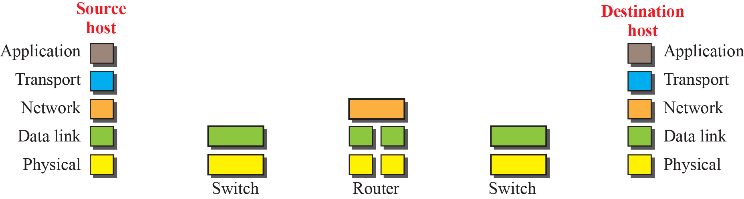
TCP/IP Communication at Network Layer

Slide 29

TCP/IP Addressing at different Layer

Slide 30

TCP/IP Physical Addressing
07:01:02:01:2C:4B
A 6-byte (12 hexadecimal digits) physical address.

Slide 31

TCP/IP Logical Addressing
The physical addresses will change from hop to hop, but the logical addresses usually remain the same.

Slide 32

TCP/IP Port Addressing
753
A 16-bit port address represented as one single number.

Slide 33

TCP/IP and OSI Compared

Slide 34
OSI | TCP/IP
OSI represents Open System Interconnection. | TCP/IP model represents the Transmission Control Protocol / Internet Protocol.
OSI is a generic, protocol independent standard. It is acting as an interaction gateway between the network and the final-user. | TCP/IP model depends on standard protocols about which the computer network has created. It is a connection protocol that assigns the network of hosts over the internet.
The OSI model was developed first, and then protocols were created to fit the network architecture’s needs. | The protocols were created first and then built the TCP/IP model.
It provides quality services. | It does not provide quality services.
The OSI model represents defines administration, interfaces and conventions. It describes clearly which layer provides services. | It does not mention the services, interfaces, and protocols.
The protocols of the OSI model are better unseen and can be returned with another appropriate protocol quickly. | The TCP/IP model protocols are not hidden, and we cannot fit a new protocol stack in it.
It is difficult as distinguished to TCP/IP. | It is simpler than OSI.
It provides both connection and connectionless oriented transmission in the network layer; however, only connection-oriented transmission in the transport layer. | It provides connectionless transmission in the network layer and supports connecting and connectionless-oriented transmission in the transport layer.
It uses a horizontal approach. | It uses a vertical approach.
The smallest size of the OSI header is 5 bytes. | The smallest size of the TCP/IP header is 20 bytes.

Slide 35

Summary

Slide 36


